Slide 1

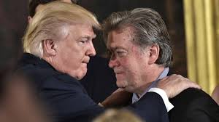
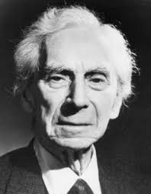
“Is there any knowledge in the world which is so certain that no reasonable man could doubt it?”
Bertrand Russell
Truth Versus ‘Truth Social’
“This is not about persuasion: This is about disorientation.”
Steve Bannon

Slide 2
The state of public dialogue today is not what it was twenty years ago.
Many politicians no longer seem to use established facts as a basis for their arguments – rather they lie about what is happening and attempt to get us to believe the lies.
Because of this public trust in politicians has fallen.

Slide 3
The state of public dialogue today is not what it was twenty years ago.
Many statesmen no longer seem to use established facts as a basis for their arguments – rather they lie about what is happening and attempt to get us to believe the lies.
Because of this public trust in politicians has fallen.
I will be arguing that this is not just a change in the moral character of a large group of world leaders and politicians but a deliberate strategy for misleading sections of the community, in order to gain their support.

Slide 4
The state of public dialogue today is not what it was twenty years ago.
Many statesmen no longer seem to use established facts as a basis for their arguments – rather they lie about what is happening and attempt to get us to believe the lies.
Because of this public trust in politicians has fallen.
I will be arguing that this is not just a change in the moral character of a large group of world leaders and politicians but a deliberate strategy for misleading sections of the community, in order to gain their support.
In this session I will attempt to explain:
The strategy which is used
The tactics which are employed
How to recognise and resist those tactics

Slide 5
A New Pattern of Anti-Philosophical Communication
If your arguments are not supported by the facts:
Replace evidence-based debate with emotional appeals.
Create "alternative facts" to support political goals
Attack fact-based media and fact-checkers
Overwhelm opponents with fabricated claims requiring response
Deploy personal attacks and identity-based divisions

Slide 6
This discussion should not be about politics. It is about the role of truth in our social and political communications. The fact that these two elements have become so intimately involved recently should form the core of our discussions.
Please intervene whenever you think we have strayed into faction politics.

Slide 7
The Vision: Divide and Rule
White Supremacy: Divide whites from other races.
Male Supremacy: Divide men and women; attack LGBT+ groups.
The Losers versus the Winners. Divide ‘working class males’, who feel they are losing their position in US society from the better-educated ‘woke’ majorities.

Slide 8
The Strategy
How It Works
Promote unfounded divisions (race, gender) through emotional appeal, not evidence.
Attack institutions as "deep state" when they constrain power.
Replace reality with persecution narrative: "They're all against us"

Slide 9
Tactics:
Appear to give less educated white males what they want:
Less educated white males want the USA to go back to some mid 20th century ideal with big inefficient cars and the old heavy industries – a white male-dominated society. They don’t want to change their lives in any way so they:
  Deny that the ‘greenhouse effect is real, and drive that view home with real countermeasures:
    Subsidise and protect traditional industries like coal, oil and steel
    Stop government projects involving wind generators
    Stop subsidies on Electric Vehicles
  Attack ‘elitist’ institutions like the top universities
    Stop their subsidies
    Control their boards
    Control the influx of overseas students

Slide 10
Tactics:
Ethnic. Tacitly and explicitly support the view that the ‘real’ USA is being undermined by the growth of ethnic minorities.
  Abuse racial minorities: Somalis are ‘garbage’ and eat dogs and cats.
  Hispanic immigrants are drug dealers and rapists.
  Ban visitors from ‘shithole’ countries.
  Deport as many immigrants as possible (ICE). Admit white South Africans.
  Close the Mexican border.
  Close all government departments which promote Diversity Equity and Inclusion
Gender
  Pass abortion legislation
  Openly abuse women who want to talk about issues with comments about their appearance or attitude.
  Talk in a way which reduces women to objects
  Promote the views of women who see their role in marriage as subservient to men.

Slide 11
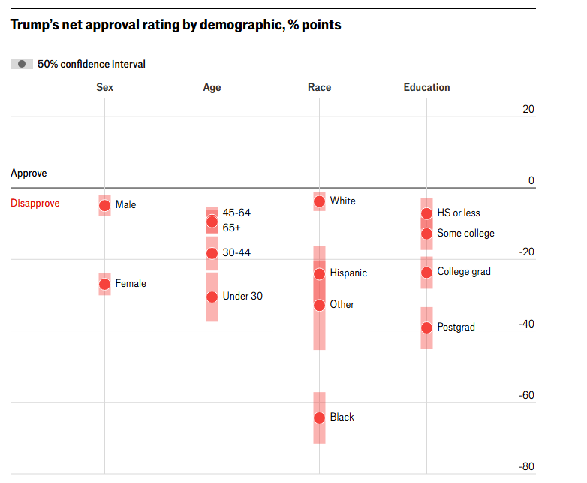
Gender Divide
Age Divide
Racial
Divide
Educational
Divide

Slide 12
Undermining the concept of a reasoned,
evidence-based debate
In Trump’s first government The Washington Post recorded 30,000 statements based on false or misleading information.
In his second government, there has been a structural shift. The lies and falsehoods have escalated to such an extent that they are impossible to discuss individually:
Meta announced an end to its fact-checking program in the U.S. in January 2025, just before Trump's inauguration.
Some organizations stopped: In February, Tegna ended its centralized VERIFY initiative, and in April, The Daily Caller stopped updating its Check Your Fact initiative

Slide 13
Techniques used to subvert evidence-based debate
Evidence versus noise
Conspiracy Theories: “What these guys aren’t telling you.”

Slide 14
Argument versus Noise
There is a difference between arguing against a claim and burying it.
1. A proper argument takes time.
2. It identifies what is being claimed.
3. It tests evidence.
4. It accepts correction.
What we increasingly see instead is something very different.

Slide 15
Argument versus Noise
There is a difference between arguing against a claim and burying it.
1. A proper argument takes time.
2. It identifies what is being claimed.
3. It tests evidence.
4. It accepts correction.
What we increasingly see instead is something very different.
"The Democrats don’t matter. The real opposition is the media. And the way to deal with them is to flood the zone with sh**."
Steve Bannon

Slide 16
How the Tactic Works
Suppose I make a clear claim “X causes Y.”: and you want to dispute that claim:
To respond properly, you would need to show:
that X does not occur,
or that Y does not occur,
or that the link between them fails.

Slide 17
How the Tactic Works
Suppose I make a clear claim “X causes Y.”: and you want to dispute that claim:
To respond properly, you would need to show:
that X does not occur,
or that Y does not occur,
or that the link between them fails.
That takes effort. Instead, the ‘Bannon-type’ response is this:
throw out ten loosely related objections,
mix facts with anecdotes,
add emotional colour,
move on before anything is resolved.
Nothing has been refuted — but nothing feels settled either.
And once uncertainty feels permanent, truth loses traction.

Slide 18
A Familiar Example: Wind Turbines. Donald Trump has claimed that wind turbines:
cause cancer,
kill massive numbers of birds
make people ill
destroy economies
don’t work when the wind isn’t blowing
Each claim is easy to state, each requires time and evidence to dismantle, and none needs to survive scrutiny for the tactic to succeed.
By the time one claim is corrected, more have landed.
The result is not belief — it is residual distrust.
The goal is not to persuade you of an alternative truth, but to exhaust your confidence that truth can be established at all.

Slide 19
Conspiracy Theories:
“The reason you can’t get ahead in life is that the deck is secretly stacked against you.”
QAnon is a conspiracy theory movement that emerged around 2017:
The central narrative was that Donald Trump was secretly fighting a cabal of Satan-worshipping pedophiles who controlled governments, media, and finance. An anonymous figure called "Q" supposedly had high-level government clearance and posted cryptic messages revealing this alleged conspiracy.

Slide 20
Conspiracy Theories:
“The reason you can’t get ahead in life is that the deck is secretly stacked against you.”
QAnon is a conspiracy theory movement that emerged around 2017. :
The central narrative was that Donald Trump was secretly fighting a cabal of Satan-worshipping pedophiles who controlled governments, media, and finance. An anonymous figure called "Q" supposedly had high-level government clearance and posted cryptic messages revealing this alleged conspiracy.
Trump signalled that Epstein was involved in this sort of group. Hence the backlash from MAGA at Trump’s obvious involvement with Epstein.

Slide 21
Conspiracy Theories:
Key false claims included:
A coming "Storm" or mass arrest event where Trump would round up these conspirators
That prominent Democrats and celebrities were involved in child trafficking through coded references (like the debunked "Pizzagate" conspiracy)
That Special Counsel Robert Mueller was secretly working with Trump rather than investigating him
Various date-specific predictions about arrests and revelations that never materialized

Slide 22
Gaslighting
Common examples include:
Denying something happened when it clearly did ("I never said that")
Trivializing someone's feelings ("You're being too sensitive")
Shifting blame to the victim ("You're remembering it wrong")
Presenting false information as fact to confuse someone. (I won the 2020 election)
Claiming the other person is "crazy" or unstable when they raise legitimate concerns
These techniques combine to make certain individuals question their grasp of reality and to accept ever more extreme falsehoods.

Slide 23
Some common (logically false) ways to make an argument
If we ban SUVs because they are bad for the environment, eventually the government will ban all cars, so we should not ban SUVs. (Slippery slope)
I drank bottled water and now I am sick, so the water must have made me sick. (Post hoc ergo propter hoc)
Filthy and polluting coal should be banned. (Question begging)
Eat dung – fifty billion flies can’t be wrong. (Bandwagon)
Trump is wrong about the border wall, because Trump is wrong about everything (Ad hominem)
The Chinese sell wind generators to everybody else, they don’t use them in China (a credible-sounding lie)

Slide 24
General Discussion
My argument: Electric Cars are better for the environment because they don’t generate CO2 and reduce global warming.
Off the top of your heads, please give me six ‘Bannon-type’ arguments against this.

Slide 25
We are going to separate different kinds of evidential methods that are coming under attack worldwide.

Slide 26
Evidence which is generated by statistical methods is untrue

Slide 27
Truth ≠ Certainty
Core mistake:
“If something is only probable it might as well be untrue”. That is false.

Slide 28
Truth ≠ Certainty
Core mistake:
“If something is probabilistic, it might as well be untrue”. That is false.
Example
“Tomorrow it will rain. As given in a Met Office weather forecast ”
– This is probabilistic. (One day Met Office forecast 90% accurate, 7 day 80%)
– It is not arbitrary, not opinion, and not equivalent to falsehood.

Slide 29
Truth ≠ Certainty
Core mistake:
“If something is probabilistic, it might as well be untrue”. That is false.
Example
“Tomorrow it will rain. As given in a Met Office weather forecast ”
– This is probabilistic. (One day Met Office forecast 90% accurate, 7 day 80%)
– It is not arbitrary, not opinion, and not equivalent to falsehood.
Probability is about limited access, not lack of truth.
The world does not become vague because we are ignorant.

Slide 30
Truth from Statistics: Examples
“Smoking causes cancer.”
– This is statistically established.
– It does not mean every smoker gets cancer.
– It does mean denying the causal link is irrational.
Seatbelts reduce fatalities.
– Not a moral opinion.
– Not invalidated because some people survive crashes without them.

Slide 31
Truth from Statistics:
Example: “Smoking causes cancer.”
– This is statistically established.
– It does not mean every smoker gets cancer.
– It does mean denying the causal link is irrational.
Seatbelts reduce fatalities.
– Not a moral opinion.
– Not invalidated because some people survive crashes without them.
Simple formulation:
Statistics don’t make claims true — they reveal patterns that would be invisible otherwise.

Slide 32
Evidence from Experts

Slide 33
“I Don’t Trust Experts”
Yes, experts can be wrong, institutions can fail.
But the critical distinction is that of: Expertise vs Authority
Expertise = track record + method + correction mechanisms.
Authority = “Because I say so.”

Slide 34
“I Don’t Trust Experts”
Yes, experts can be wrong, institutions can fail.
But the critical distinction is that of: Expertise vs Authority
Expertise = track record + method + correction mechanisms.
Authority = “Because I say so.”
Crucial point:
Distrusting experts as a class is problematical — because making that distinction itself depends on expert knowledge. We generally know when to trust experts.

Slide 35
Questions for Groups:
Let’s say your grandchildren want to go to university to study Medicine, Geophysics, Chemical engineering, etc. If you didn’t believe that they would become experts in these fields, why would you encourage them to go?
When you say you don’t trust experts, what sort of experts don’t you trust and why?

Slide 36
Lying about Global Warming to build a Voter Consensus

Slide 37
The overwhelming scientific consensus is that human activity is the dominant cause of observed global warming since the mid-20th century.
The scientific attitude is one of very high confidence based on converging evidence from multiple fields (atmospheric physics, oceanography, glaciology, paleoclimatology). Legitimate scientific scepticism focuses on refining details, not questioning the fundamental human role.

Slide 38
Here are some things which a government can do about global warming:
Phase out combustion-engined cars
Incentivise heat pumps
Build wind generators, solar panel farms and biofuels
Stop pumping oil and mining coal
What does that mean for us?
We ought to buy electric cars
We ought to convert to heat pumps
We ought to put solar panels on our roofs
If we don’t want to do these things what do we say?
“Look at the weather today, so much for global warming”
“You use more CO2 to build the electric car, than you save when you use it”
“I saw a guy on TV yesterday who said it was all nonsense.”
“If nobody else is doing it, why should I?”

Slide 39
In the USA, 70% of Democrats say human activity contributes a great deal to climate change, while only 20% of Republicans say the same.
In the UK, 71% of voters believe climate change is caused by human activity.

Slide 40

George Orwell — “manipulation thrives where distinctions collapse”
The slippery path to relativism:
Truth is uncertain
All views are equal
Evidence is optional
You decide what “feels true”
And what you decide is what feels good to you- economically and emotionally

Slide 41
This then, is how US government policy works:
If you undermine the findings of scientists and state officially that no one knows what is causing climate change then those members of the public who want things to stay as they are (or go back to what we were) will favour these policies:
Remove subsidies from electric vehicles
Pump more oil
Legislate against wind generators
Protect coal mines
Do these things and these people will tend to vote for you.

Slide 42
Based on the most recent 2024 Gallup polling, 37% of Americans believe God created the world and humanity within the past 10,000 years — the strict creationist view.
Discussion topic:
Using Trump’s tactics if you wanted to win the votes of these people, what policies would you adopt? And what sort of things would you say and do?

