Slide 1
Tolstoy: Fox or Hedghog?
His art, his life and his philosophy

Slide 2
Tolstoy’s life, literature and philosophy are inseparable.

Slide 3
Tolstoy’s life, literature and philosophy are inseparable.
For this reason, it’s necessary to understand the first two aspects (life and literature) before addressing the third.

Slide 4
Tolstoy’s life, literature and philosophy are inseparable.
For this reason, it’s necessary to understand the first two aspects (life and literature) before addressing the third.
For me, Tolstoy was unique because his whole life was a test bed for the questions he posed to himself.

Slide 5
Tolstoy’s life, literature and philosophy are inseparable.
For this reason, it’s necessary to understand the first two aspects (life and literature) before addressing the third.
For me, Tolstoy was unique because his whole life was a test bed for the questions he posed to himself.
The experiment ultimately tore him and his family apart because he found no answers which would satisfy him.

Slide 6
Tolstoy’s life, literature and philosophy are inseparable.
For this reason, it’s necessary to understand the first two aspects (life and literature) before addressing the third.
For me, Tolstoy was unique because his whole life was a test bed for the questions he posed to himself.
The experiment ultimately tore him and his family apart because he found no answers which would satisfy him.
Berlin wrote a long essay to explain Tolstoy’s dilemma called ‘Tolstoy and History’

Slide 7
Tolstoy’s life, literature and philosophy are inseparable.
For this reason, it’s necessary to understand the first two aspects (life and literature) before addressing the third.
For me, Tolstoy was unique because his whole life was a test bed for the questions he posed to himself.
The experiment ultimately tore him and his family apart because he found no answers which would satisfy him.
Berlin wrote a long essay to explain Tolstoy’s dilemma called ‘Tolstoy and History’
I will first try to present Tolstoy’s life and literature.

Slide 8
Tolstoy’s life, literature and philosophy are inseparable.
For this reason, it’s necessary to understand the first two aspects (life and literature) before addressing the third.
For me, Tolstoy was unique because his whole life was a test bed for the questions he posed to himself.
The experiment ultimately tore him and his family apart because he found no answers which would satisfy him.
Berlin wrote a long essay to explain Tolstoy’s dilemma called ‘Tolstoy and History’
I will first try to present Tolstoy’s life and literature.
Then his philosophy

Slide 9
Tolstoy’s life, literature and philosophy are inseparable.
For this reason, it’s necessary to understand the first two aspects (life and literature) before addressing the third.
For me, Tolstoy was unique because his whole life was a test bed for the questions he posed to himself.
The experiment ultimately tore him and his family apart because he found no answers which would satisfy him.
Berlin wrote a long essay to explain Tolstoy’s dilemma called ‘Tolstoy and History’
I will first try to present Tolstoy’s life and literature.
Then his philosophy
I will then move on to Berlin’s critique.

Slide 10
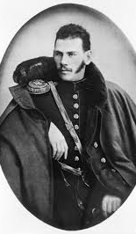
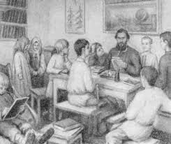
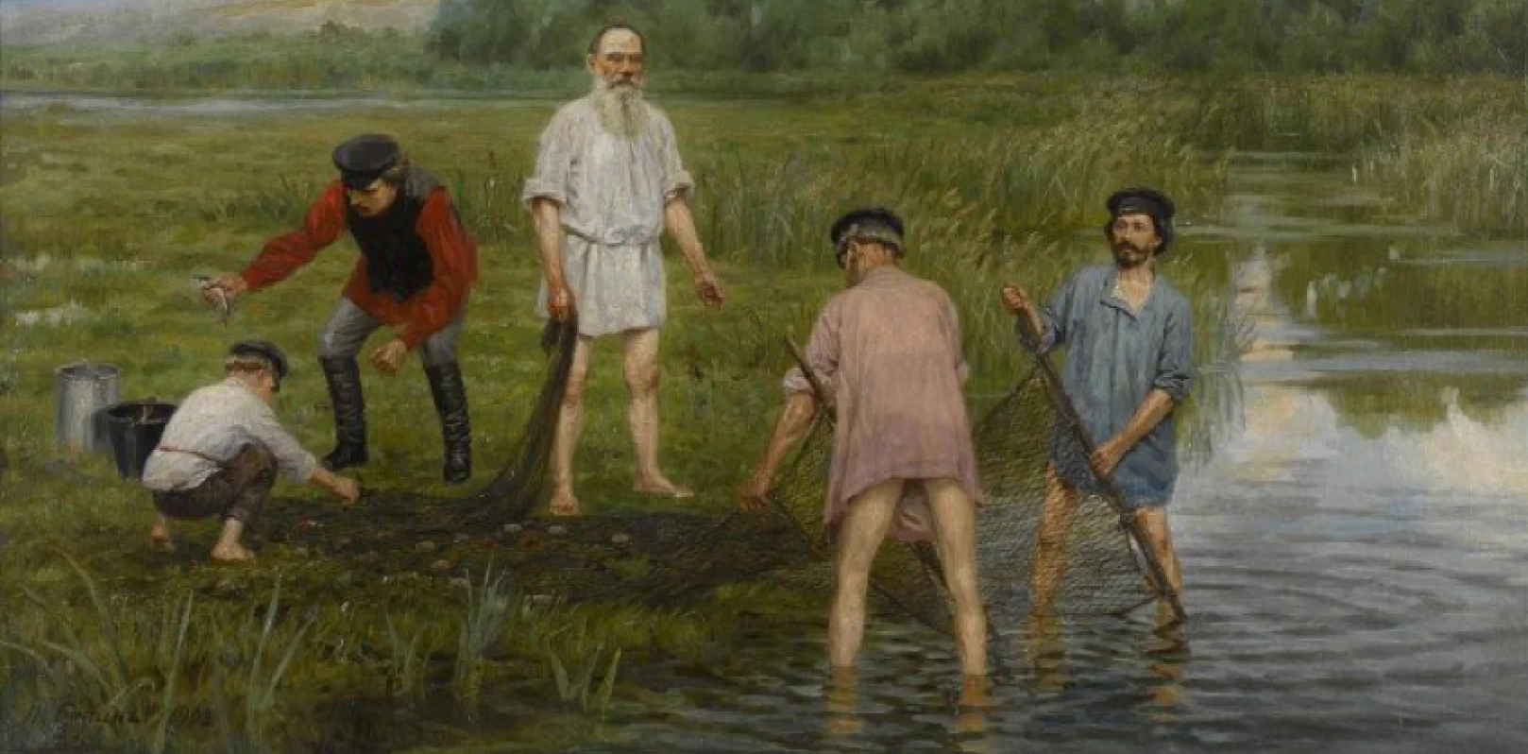
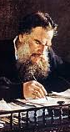
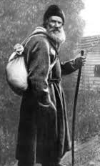
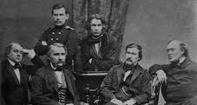
Tolstoy – everything, everywhere all at once

Slide 11
Tolstoy’s Questions
What is the meaning of life — and how should one live given that we must die? He had a terror that death renders all achievement pointless. No amount of fame, wealth, or family love could answer it.
What is God and how can I know him? He rejected dogma, miracles, and ritual, and concluded that God is essentially the moral law within us — love.
What is goodness, and how does a person actually become good? Not in theory but in practice, daily.
Is violence ever justified? Definite no. The state, armies, courts, and prisons all rest on coercion. He believed Christ's command to "resist not evil" was meant literally.
How should property and labour be organized? (Underneath this was a simpler question: why do I live in luxury while peasants starve beside me?)

Slide 12
Count Lev Nikolayevich Tolstoy
Born: 1828 - Died 1910
Born into Russian nobility as a count . The Tolstoy family was part of the old Russian aristocracy, and he inherited this title from birth as the fourth son of Count Nikolai Ilyich Tolstoy.
Wrote two internationally famous novels: War and Peace and Anna Karenina.
Wrote many other works:
Childhood, Boyhood, Youth
The Cossacks
Resurrection
The Raid
The Death of Ivan Ilyich
Svastopol Sketches
Importantly, he wrote many parables :
That whereby men live; Elias; The Grain that was like an Egg; Where love is, there is God also.
He also wrote a School primer that was used well into the Communist era.
He was hugely famous and politically influential in Russia because his parables were read by the peasantry.

Slide 13
Some Facts about Tolstoy:
He served in the Russian Army in the early 1850’s first in the Causcasus fighting the Chechens and then in Sevastopol. From the front he wrote “Sevastopol Sketches” which were an honest account of the soldiers’ experiences.
He owned 300 serfs. He tried to make arrangements to free them in the 1850’s but the serfs distrusted his arrangements and would not cooperate.
He fathered children amongst the serfs. His coach driver was also his son. This was not unusual amongst the aristocracy. He wrote an honest account of it.
Tolstoy was 34 years old when he married Sophia Andreyevna Behrs in 1862. She was 18. On the eve of his marriage, he gave her his diary. It detailed his previous affairs with women. Sophia was devastated.
The marriage, famously, was a running battle thereafter. Each kept diaries listing the failings of the other, knowing that they would be published subsequently.

Slide 14
Tolstoy started his own school for children on the Yasnaya Polyana Estate 1859-1862. He was intensively involved in the teaching for this period but then, overwhelmed, he stepped back.
Philosophy:
The schools were a profound philosophical success as a radical experiment in democratic and liberal education.
Tolstoy rejected the rigid, authoritarian teaching methods of the time. His school was founded on principles that:
Made attendance voluntary for the children.
Allowed students freedom to choose their schedule and activities (they could even leave class if bored).
Abolished all fixed curricula, examinations, and corporal punishment.

Slide 15
Tolstoy in London
During a visit to London, Tolstoy attended the English Parliament where he witnessed Lord Palmerston deliver a three-hour speech, which he found boring. He spoke 13 languages at varying levels of competence.
This visit was part of Tolstoy’s European tour (1860-61), which was primarily focused on studying Western educational methods that he could apply to the school he had established.
While in London from March 2-17, 1861, he visited various schools, attended lectures by Charles Dickens at the Athenaeum club, and spent time at the Victoria and Albert Museum.

Slide 16
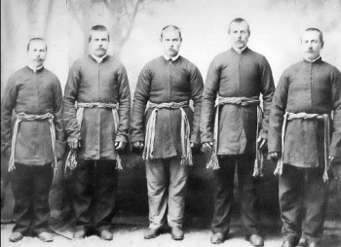
His leadership included:
International advocacy: Tolstoy became one of the most passionate protectors and friends of the Doukhobors.
Fundraising: He donated the royalties from his novel "Resurrection" and other works to the emigration fund, providing about 30,000 rubles—roughly half of the total emigration fund, raising the rest through cooperation with his followers (Tolstoyans)
Direct correspondence: He maintained ongoing correspondence the Doukhobor leader to plan their emigration.
There are still around 30,000 Doukhobors in Canada today.
Tolstoy fought against the persecution of the Dukhoubors by the Russian Government. The Dukhoubors were a religious sect that lived in communes and practised pacifism. They wouldn’t fight for Russia

Slide 17
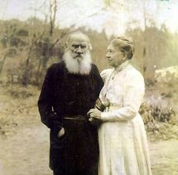
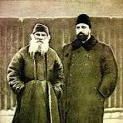
More facts about Tolstoy:
He had a love/hate relationship with the Orthodox Church and was excommunicated in 1902
1884-1910 His group of followers came to live on his estate. (Tolstoyans, led by Chertkov) Chertkov became Tolstoy’s most devoted disciple, literary executor, and "trusted secretary."
Chertkov spent significant amounts of time at Yasnaya Polyana during these years, particularly in the final decade of Tolstoy's life.
During this time there was constant conflict between Chertkov and his wife. This culminated in the drafting of a secret will to make his works public domain, effectively disinheriting his 8 children

Slide 18
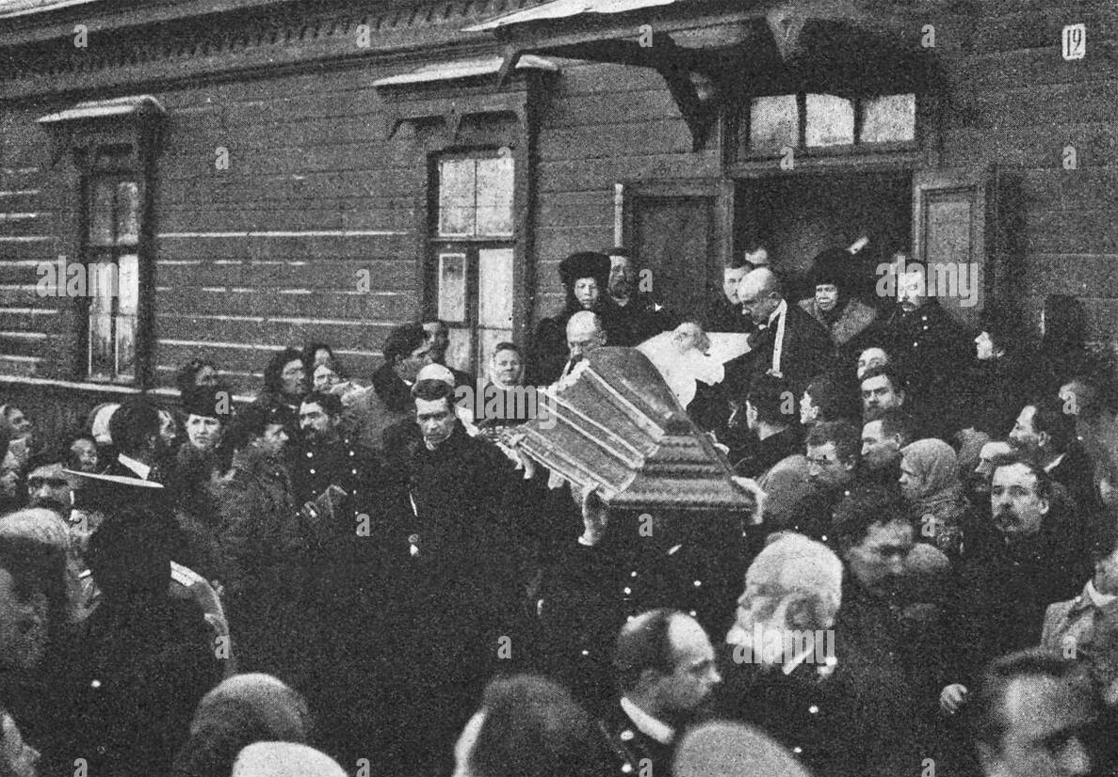
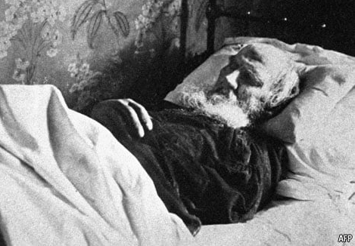
In the end Tolstoy became utterly depressed and frustrated by the arguments and the constant pressure.
He ‘made a run for it’ intending to catch a train at Astapovo station, but instead he contracted pneumonia and was too ill to move.
His wife arrived but his followers wouldn’t allow her to enter.
The national media gathered and there is early film of his wife walking up and down the platform waiting to be admitted. She was only admitted after he lost consciousness.

Slide 19
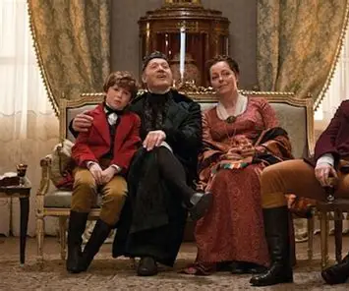
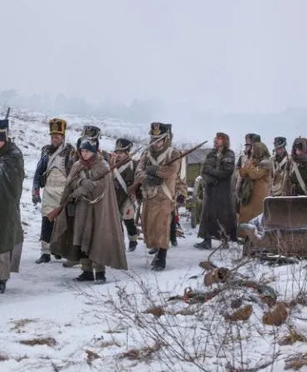
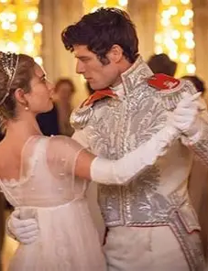
A Quick Analysis of Tolstoy’s War and Peace

Slide 20
War and Peace:
The Main Characters
War and Peace
Pierre Bezuhov
The Bolkonskys
Andrei,
Maria
Their father
The Rostovs
Nikolai
Natasha
Petya

Slide 21
War and Peace:
The Relationships
Searching:
Absent-minded, Trusting, Good-natured
Pierre Bezuhov
The Bolkonskys
Andrei,
Maria
Their father
Close Friends
Attraction
Attraction
Spiritual: analytical, passionate, aloof
The Rostovs
Nikolai
Natasha
Petya
Life happens to them:
Vital, Happy,
Chaotic

Slide 22
War and Peace:
The Characters and their Circle
Brave, cold, cruel, Dangerous
Dolohov
Searching:
Absent-minded, Trusting, Good-natured
Pierre Bezuhov
The Kuragins
The Bolkonskys
Andrei,
Maria
Their father
Close Friends
Boris Drubetskoy and his mother
Attractive, amoral, ignorant
manipulative
Attraction
Attraction
Spiritual: analytical, passionate, aloof
The Rostovs
Nikolai
Natasha
Petya
Life happens to them:
Vital, Happy,
Chaotic
Poor, Aristocratic ‘On the make’’
Good natured, supportive, friendly
Denisov

Slide 23
War and Peace:
The Main Characters and their Circles
Brave, cold, cruel, Dangerous
Dolohov
Kutuzov and his associates
Searching:
Absent-minded, Trusting, Good-natured
Pierre Bezuhov
The Kuragins
The Bolkonskys
Andrei,
Maria
Their father
Close Friends
Boris Drubetskoy and his mother
Attractive, amoral, ignorant
manipulative
Attraction
Attraction
Spiritual: analytical, passionate, aloof
The Rostovs
Nikolai
Natasha
Petya
Life happens to them:
Vital, Happy,
Chaotic
Poor, Aristocratic ‘On the make’’
Napoleon and his associates
Good natured, supportive, friendly
Denisov
The Emperor Nikolai II and his court

Slide 24
Tolstoy’s philosophical analysis concluding War and Peace:
the role of a ‘national spirit’ as the unconsciously expressed will of the people.
‘Cometh the hour. Cometh the man.’ (but not necessarily in a good way).
In ‘War and Peace’, he describes two characters, Napoleon and the Russian general Kutuzov. They each believe they expressed the collective aspirations of their respective peoples.
Napoleon believed he was a great man, and that he controlled France’s destiny, but time and time again, Tolstoy demonstrates how the behaviour of the French army in Russia had nothing to do with him. He argues that he was a necessary tool of the French desire for supremacy but this agency was spent.
Kutuzov understood that he was there to act out the general will of the Russian people, he was attuned to it and thereby gained the ultimate victory.

Slide 25
Kutuzov – Tolstoy’s model
Kutuzov is mostly Tolstoy’s historical fabrication – the man who instinctively feels what Tolstoy wants to understand.
Kutuzov accepts that he cannot control events.
His wisdom is negative: knowing the limits of knowledge.
Passive, fatalistic, yet somehow wise.
Does NOT have a theory - just lives by trusting intuition and emotion. He defeats Napoleon by this approach.
This is what Tolstoy aspires to but cannot BE.
Kutuzov is at peace with fox-nature; Tolstoy never is.

Slide 26
Some observations about Tolstoy’s literature:
A. N. Wilson argues convincingly that Tolstoy wrote from his own life experiences and when he had used them up, he became a national prophet.
Tolstoy didn’t just write characters, he wrote families. Each family member manages to be different from the others and somehow, recognisably the same.
No character is perfect. Each has weaknesses and flaws, and Tolstoy shows how the nature of life makes this inevitable. His view, I believe, is this:
If your life is to be well-lived, you have to commit to something, but that commitment itself will inevitably involve you in ‘selfishness’ and conflict.
In Pierre and Andrei, Tolstoy was working through two aspects of his character: the dreamer and the seeker for spiritual truth. He sees himself as Pierre, (he draws an almost identical character, Levin ,in Anna Karenina) but to me, Tolstoy is mostly Andrei.

Slide 27
Group questions:
Below are some of Tolstoy’s questions. Are they well posed? Or are they based upon questionable assumptions? Could they ever be definitively answered?
Does our modern way of living make them look hopelessly Victorian or irrelevant? Or are they relevant questions which we have stopped asking?
What is the meaning of life — and how should one live given that we must die and death renders all achievement pointless?
What is goodness, and how does a person actually become good? Not in theory but in practice, daily.
Is violence ever justified?
How should property and labour be organized?

Slide 28
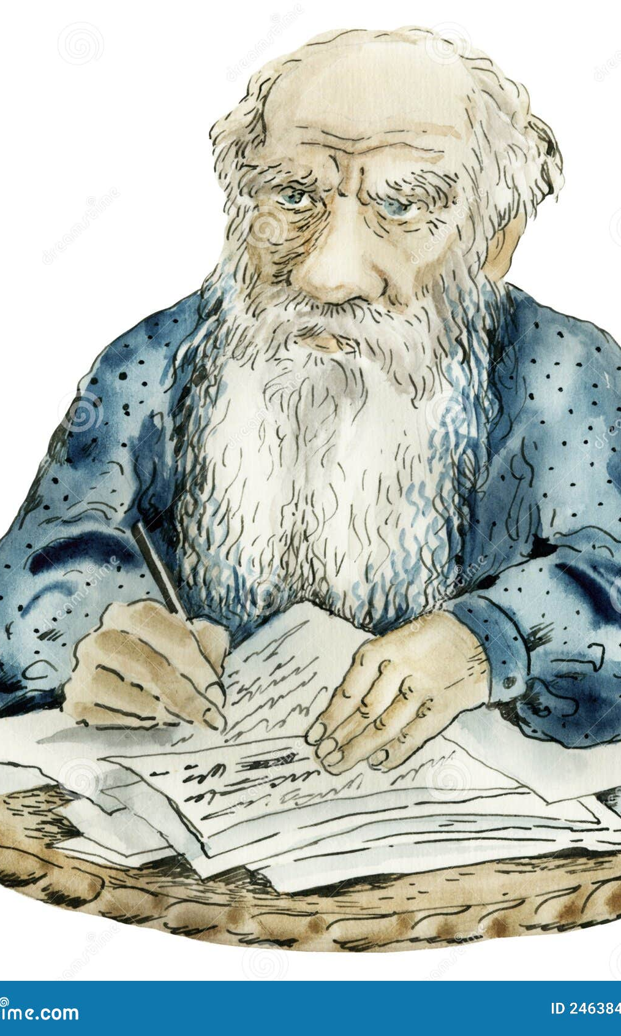
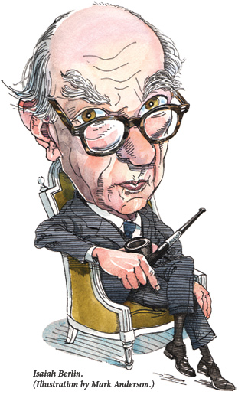
Isaiah Berlin: Tolstoy and History

Slide 29
Isaiah Berlin, a Cambridge philosopher, wrote a paper called ‘Tolstoy and History’
In the next few slides, I will try to present his views on Tolstoy’s work and life.
The argument is interesting, but I don’t agree with all of the points he made.

Slide 30
Archilochus (Greek poet): “The fox knows many things, but the hedgehog knows one big thing.”
The Core Framework:
Berlin opens by establishing this distinction as a metaphor for two types of thinkers:
Hedgehogs: those who relate everything to a single central vision, one organizing principle (like Plato, Dante, Hegel, Dostoevsky)
Foxes: those who pursue many ends, often unrelated or contradictory, with no single overarching system (like Aristotle, Shakespeare, Montaigne, Goethe)

Slide 31
The Hedgehog Mind
Relates everything to a single central vision
One universal organizing principle through which all experience is understood
Examples: Plato (Forms), Dante (divine hierarchy), Hegel (dialectical Spirit)
Also: Nietzsche, Schopenhauer, Wittgenstein’s Tractatus - unified worldviews
Seeks coherence, system, the reduction of multiplicity to unity

Slide 32
The Fox Mind
Pursues many ends, often unrelated and even contradictory
Examples: Aristotle, Shakespeare, Montaigne, Molière,
Pushkin, Balzac, Joyce - embrace multiplicity
Comfortable with diversity, scattered vision, irreducible particularity

Slide 33
Berlin’s Central Argument: Tolstoy's Contradiction
Tolstoy was BY NATURE a fox.
But BELIEVED IN BEING a hedgehog.
This is the source of his philosophical torment.
For Tolstoy, the internal war was between his gifts and his aspiration, his vision and his belief.
War and Peace was the supreme battleground of this conflict.

Slide 34
Tolstoy's Fox Nature: The Perceptual Gift
Unequalled capacity for concrete, immediate perception.
Can render the texture of lived experience with incomparable vividness.
Sees and captures the richness of lived experience.
The 'small' truths: how Nikolai feels on the battlefield. How Natasha at 12 thinks about love. The sudden feeling of renewal Andrei feels when he sees an old oak tree, seemingly dead, suddenly coming to leaf in spring.

Slide 35
Examples of complex, unstructured perception in War and Peace
Battle scenes: not strategic diagrams but chaos, confusion, accident. He’d lived this.
No character has a complete view; all perspectives are partial.
Pierre at Borodino: bewilderment, not heroic clarity.
Napoleon's delusion of control vs. the reality of contingency.
Kutuzov's wisdom: knowing he cannot know, accepting limits.
The lived experience of war (Fox) vs. the military-historical abstraction (Hedgehog).

Slide 36
Despite this ability to capture the minutiae of life, Tolstoy has the ‘Hedgehog’ Aspiration
Desperate for a unified theory of history
Rejects 'great man' theory as false, superficial
Seeks the 'laws' governing human affairs
Wants to explain WHY things happen as a system
Writes a long philosophical conclusion to War and Peace

Slide 37
The ‘Hedgehog’ Historical Theory in War and Peace
History is NOT made by great individuals
Napoleon and Alexander are self-deceived puppets
Events are determined by countless microscopic causes
Individual 'will' and 'decision' are illusions
We rationalize ex post facto what we couldn't control
Determinism is found in the general sentiment of the people: the hedgehog system Tolstoy claims to have found

Slide 38
Berlin's Critique: The Theory Contradicts the Art
The philosophical passages ASSERT determinism.
But the narrative DEMONSTRATES individual consciousness as real.
We experience Pierre, Natasha, Andrei as genuinely choosing, feeling, living.
The theory says they're determined; the art says they're alive.
Tolstoy's fox-genius undermines his hedgehog-theory.
The novel is richer than its own explicit philosophy.

Slide 39
The Nature of Tolstoy's Determinism
Tolstoy believed our lives are determined, not by physical laws or materialist laws (Marx) but by the working out of our unstudied day-to-day experiences.
The meaning of life is only understood as the sum of infinite small causes and this is 'what has to be’.
But ultimately, Tolstoy can’t know how this mysterious ‘life force’ works itself through, yet he desperately WANTS to know.
We must conclude that his determinism is an act of faith, not discovery.

Slide 40
Why This Matters for Tolstoy: The Existential Dimension
Tolstoy cannot accept the meaninglessness of fox-vision which consists of multiple, contradictory truths causing unbearable chaos.
He needs unified meaning, moral certainty, the right answer.
This drives him toward his later, more dogmatic beliefs.
The artist's gift becomes a torment when seeking ‘the ultimate system.’
Berlin: Tolstoy's tragedy is being unable to accept his own nature

Slide 41
Berlin’s view of Tolstoy’s predicament:
Tolstoy despises rational abstract systems though he is constantly testing his own.
Rejects liberal faith in reason, progress, reform.
Sees intellectual theories as divorced from life.
Yet he wants to defeat rationalism WITH a rational system.
The contradiction of the anti-systematic systematizer.

Slide 42
Berlin’s conclusion
War and Peace succeeds as art against its philosophy.
Berlin: Tolstoy is great just because he's a fox, not because he's a hedgehog.

Slide 43
The Broader Implications
History may not have 'laws' in Tolstoy's sense
Our lives are not necessarily governed by a single principle
Berlin says we must learn to live with this

Slide 44
But Berlin had his own axe to grind…..
Berlin is himself a fox (pluralist, anti-systematic).
Values Tolstoy's artistic vision over his philosophy.
Sees monism (one big answer) as dangerous.
Pluralism: some values are irreducibly in conflict.
Tolstoy's tragedy: he couldn't accept moral complexity.
Berlin’s essay is used to support argument for fox-wisdom
It’s important to note that Berlin’s recent past had been heavily affected by totalitarian theories – Marxism and Nazism.

Slide 45
Group Questions:
Is it possible for the intimate structure of life to be immensely complex whilst at the same time understandable in terms of a single unifying theory?
Was Berlin right to be cautious about anyone who believed that life can be explained by such a theory?
Does Tolstoy’s ‘great man’ theory constitute an overarching explanatory theory of life anyway?

Slide 46
My view (for what it’s worth):
Tolstoy’s ‘great man’ theory is useful, if only because we tend to blame leaders for enacting the policies the nation voted for. When things go wrong, we are too often prone to blaming leaders, when the fault should be laid at the electorate’s door.
We too are responsible for the direction the country takes. When an electorate votes in a party or person, it has a duty to think very carefully about what the result of that decision might be.
Small scale chaos in life choices can often be accurately summarised into large scale trends. That’s how psychology works.
I think Tolstoy is right when he suggests that we function at our best as nations and communities when we live our lives in a spontaneous but not unprincipled way and show kindness to others.

