Slide 1
Life, the Universe… EVERYTHING!

Slide 2
Life, the Universe… EVERYTHING!
Why aren’t we talking about the MEANING of Life, the Universe..EVERYTHING?

Slide 3
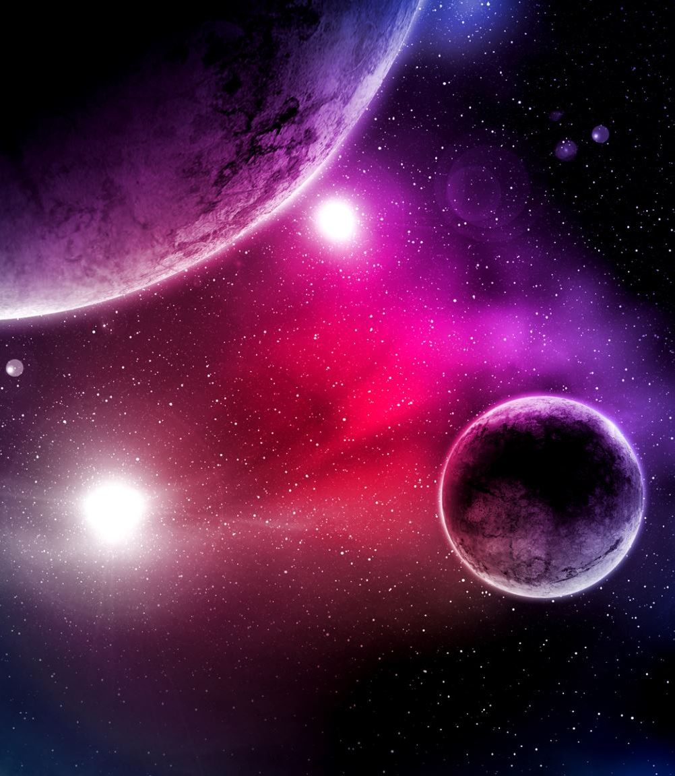
Questions for today.
What makes life different?
How did life on Earth begin?
What are the odds of life on other planets?
Will we ever travel outside the solar system?

Slide 4
What makes life different?
It always consists of highly ordered, complex, functioning structures of matter. (Human DNA is the most complex known structure in the universe)

Slide 5
What makes life different?
It always consists of highly ordered, complex, functioning structures of matter. (Human DNA is the most complex known structure in the universe)
These structures reproduce to create new structures which are entirely (or almost) exact copies of themselves.

Slide 6
What makes life different?
It always consists of highly ordered, complex, functioning structures of matter. (Human DNA is the most complex known structure in the universe)
These structures reproduce to create structures which are entirely (or almost) exact copies of themselves.
Primitive life structures can be understood as matter which is extending and evolving through time in accordance with a set of principles (natural selection)

Slide 7
Abiogenesis: the Science of Life Formation – Big Problems
We can track life back a long way through the science of ‘neo-genetics’ but not even close to its earliest form.

Slide 8
Abiogenesis: the Science of Life Formation – Big Problems
We can track life back a long way through the science of ‘neo-genetics’ but not even close to its earliest form.
There are simple molecules which occur naturally on Earth which might be assembled to build complex reproducing molecules. ( Such as carbon dioxide, methane, formaldehyde, amino acids, sugars, fatty acids.)

Slide 9
Abiogenesis: the Science of Life Formation – Big Problems
We can track life back a long way through the science of ‘neo-genetics’ but not even close to its earliest form.
There are simple molecules we find forming naturally on Earth which might be assembled to build complex reproducing molecules. ( Such as carbon dioxide, methane, formaldehyde, amino acids, sugars, fatty acids.)
So how did these molecules come to form reproducing structures?

Slide 10

Abiogenesis: the Science of Life Formation
Big Problem: ENTROPY
The big problem is that the universe becomes more disordered over time
If you drop a glass, it will break into lots of pieces but if you drop the pieces, they’ll never become a glass. Increasing disorder is probably the most fundamental law of this universe.

Slide 11
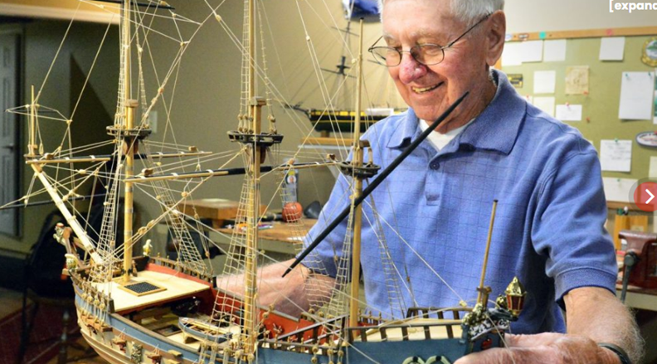
Imagine bringing together all the right pieces of timber, rope, bolts etc.. to build a sailing ship.
Imagine shaking them around for a billion years, they still wouldn’t make a sailing ship. The chances that simple molecules will randomly combine to form a complex reproducing molecule are effectively zero.

Slide 12
Abiogenesis: the Science of Life Formation – some other problems:
Despite the odds, let’s assume that you get the first reproducing chemical molecule:

Slide 13
Abiogenesis: the Science of Life Formation – some other problems:
Assume you get the first reproducing chemical molecule:
It needs to consume the right sort of molecules to multiply.

Slide 14
Abiogenesis: the Science of Life Formation – some other problems:
Assume you get the first reproducing chemical molecule:
It needs to consume the right sort of molecular ‘foodstock’ to multiply
When all those molecules are used up, reproduction stops.

Slide 15
Abiogenesis: the Science of Life Formation – some other problems:
Assume you get the first reproducing chemical molecule:
It needs to consume the right sort of molecules to multiply
When all those molecules are used up, reproduction stops.
So OK, let’s assume that these ‘food’ molecules are everywhere.

Slide 16
Abiogenesis: the Science of Life Formation – some other problems:
Assume you get the first reproducing chemical molecule:
It needs to consume the right sort of molecules to multiply
When all those molecules are used up reproduction stops.
So OK, let’s assume that these ‘food’ molecules are everywhere.
You’ll get one very successful reproducing molecule covering the surface of the planet. But it’s still just a reproducing chemical. There is no competing chemical to start an evolutionary process.

Slide 17
Abiogenesis: the Science of Life Formation – some other problems:
Assume you get the first reproducing chemical molecule:
It needs to consume the right sort of molecules to multiply
When all those molecules are used up reproduction stops.
So OK, let’s assume that these ‘food’ molecules are everywhere.
You’ll get one very successful reproducing molecule covering the surface of the planet. But it’s still just a reproducing chemical. There is no competing chemical to start an evolutionary process.
So, let’s assume you have two competing reproducing chemicals?

Slide 18
Abiogenesis: the Science of Life Formation – some other problems:
Assume you get the first reproducing chemical molecule:
It needs to consume the right sort of molecules to multiply
When all those molecules are used up, reproduction stops.
So OK, let’s assume that these ‘food’ molecules are everywhere.
You’ll get one very successful reproducing molecule covering the surface of the planet. But it’s still just a reproducing chemical. There is no competing chemical to start an evolutionary process.
So, let’s assume you have two competing reproducing chemicals?
Same as above but we have two chemicals covering the Earth’s surface.

Slide 19
Abiogenesis: the Science of Life Formation – some other problems:
Assume you get the first reproducing chemical molecule:
It needs to consume the right sort of molecules to multiply
When all those molecules are used up, reproduction stops.
So OK, let’s assume that these ‘food’ molecules are everywhere.
You’ll get one very successful reproducing molecule covering the surface of the planet. But it’s still just a reproducing chemical. There is no competing chemical to start an evolutionary process.
So, let’s assume you have two competing reproducing chemicals?
Same as above but we have two chemicals covering the Earth’s surface.
To conclude: if, for life to evolve, you need lots of different reproducing competing molecules very early on, and it’s hard to figure how you do this from the formation of the first reproducing molecule.

Slide 20
Jeremy England has recently proposed a solution:
For life to start, you need lots of competing complex molecules and you need something to catalyse the formation of complex molecules.

Slide 21
Jeremy England has recently proposed a solution:
For life to start, you need lots of competing complex molecules and you need something to catalyse the formation of complex molecules.
He has proposed this ‘push’ to complexity is provided by entropy.

Slide 22
Jeremy England has recently proposed a solution:
For life to start, you need lots of competing complex molecules and you need something to catalyse the formation of complex molecules.
He has proposed this ‘push’ to complexity is provided by entropy.
But….. hang on – didn’t I just say that entropy is promoting disorder?

Slide 23
Jeremy England has recently proposed a solution:
For life to start, you need lots of competing complex molecules and you need something to catalyse the formation of complex molecules.
He has proposed this ‘push’ to complexity is provided by entropy.
But….. hang on – didn’t I just say that entropy is promoting disorder?
“Yes,” says England, “but if local complexity creates greater disorder overall, it will still be preferred.”

Slide 24
Jeremy England has recently proposed a solution:
For life to start, you need lots of competing complex molecules and you need something to catalyse the formation of complex molecules.
He has proposed this ‘push’ to complexity is provided by entropy.
But….. hang on – didn’t I just say that entropy is promoting disorder?
“Yes,” says England, “but if local complexity creates greater disorder, it will be preferred.”
England has demonstrated that stable complex molecules will form in solution when exposed to an external energy source like thermal underwater ocean vents, shallow pools in sunlight etc…

Slide 25
Jeremy England has recently proposed a solution:
For life to start, you need lots of competing complex molecules and you need something to catalyse the formation of complex molecules.
He has proposed this ‘push’ to complexity is provided by entropy.
But….. hang on – didn’t I just say that entropy is promoting disorder?
“Yes,” says England, “but if local complexity creates greater disorder, it will be preferred.”
England has demonstrated that stable complex molecules will form in solution when exposed to an external energy source like thermal underwater ocean vents, shallow pools in sunlight etc…
So, you can form lots of stable complex chemicals across Earth surfaces over time, and if any of them are reproducing, then they have foodstock available.

Slide 26
Jeremy England has recently proposed a solution:
For life to start, you need lots of competing complex molecules and you need something to catalyse the formation of complex molecules.
He has proposed this ‘push’ to complexity is provided by entropy.
But….. hang on – didn’t I just say that entropy is promoting disorder?
“Yes,” says England, “but if local complexity creates greater disorder, it will be preferred.”
England has demonstrated that stable complex molecules will form in solution when exposed to an external energy source like thermal underwater ocean vents, shallow pools in sunlight etc…
So, you can form lots of stable complex chemicals across Earth surfaces over time, and if any of them are reproducing, then they have foodstock available.
But why on Earth and nowhere else? Perhaps because Earth has had surface water incident sunlight and relatively stable geology for billions of years.

Slide 27
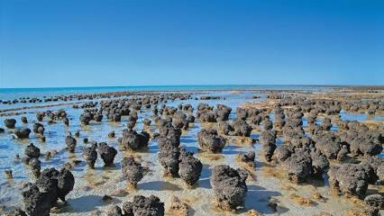
When did Matter become Life?
4.54 billion years ago – Earth forms.
Around 4.0 billion years ago – liquid water appears.
3.5–3.8 billion years ago – The first known signs of life show up, mostly as microbial mats or stromatolites in ancient rocks.

Slide 28
Stromatolites form mats of microrganisms which bind with particles of rock for stability and then form layers to create the structures you see here.
Importantly they contain RNA (amongst other things).
All life today contains RNA.

Slide 29
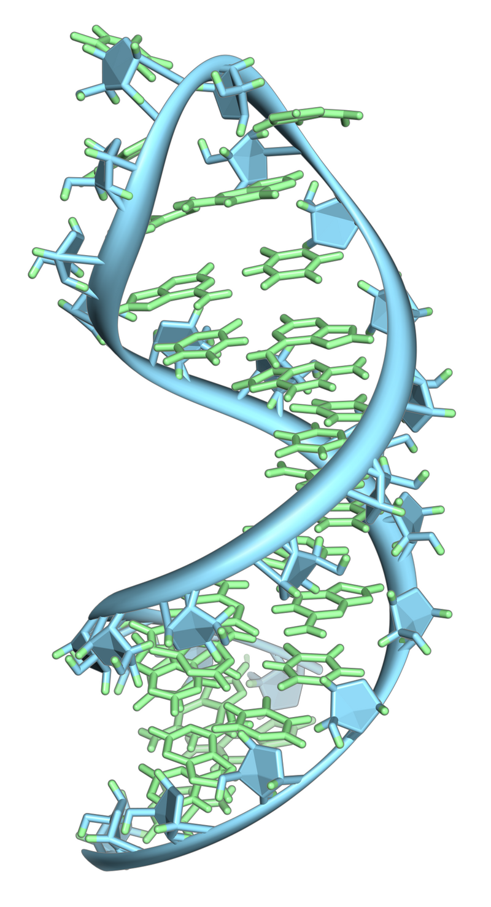
RNA is a complex organic structure. There is no chance that it was the first reproducing molecule, but it has clearly been the most successful one

Slide 30
So, given it takes, liquid water and stable geological conditions for reproducing molecules to form (after 300-400million years), and it probably took 5 times longer for multi-cellular organisms to form - and 10 to 20 times longer for animal and plant life to form, what do we think are the chances of other life forms being out there?

Slide 31
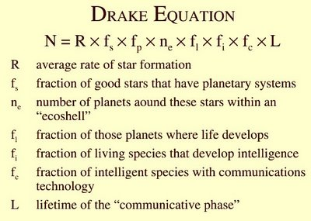

Slide 32
Some Problems with the Drake formula:
If we don’t really know how life started on Earth, it’s hard to figure out the probabilities of it starting elsewhere.
Life need not be carbon-based, the only other ‘intelligent’ entity we’ve been able to create is silicon-based.
The transition to multi-cellular organisms took much longer than it did for reproducing, single-celled organisms to form. That might be the greatest barrier – not initial life formation.
We have no idea how long an intelligent civilisation could last. If a civilisation was really smart, surely it could survive for billions of years? If you could reduce an intelligence to a detection system and a pattern of information, isn’t it possible to preserve it forever?

Slide 33
Another question:
If we find traces of life on Mars, doesn’t that improve our chances of finding life elsewhere?
Simple answer is ‘Yes’
Mars did have liquid water but lost its water and its atmosphere 3.5 – 4 billion years ago, because its magnetic field faded. This emphasises the likely importance of geological stability on Earth.
But how likely are we to find traces of organisms on the surface of the planet after all this time?
And if we (as we have) found chemical structures which might be indicative of life, how careful are we in verifying this?
A lot of people have a vested interest in finding life there .

Slide 34
Is There Anybody Out There?
SETI (Search for Extra-Terrestrial Intelligence) uses our best resources:

Slide 35
Is There Anybody Out There?
SETI (Search for Extra-Terrestrial Intelligence) uses our best resources:
Large radio and optical telescopes like the Allen Telescope Array and the Hubble Space Telescope, space-based observatories like Kepler

Slide 36
Is There Anybody Out There?
SETI (Search for Extra-Terrestrial Intelligence) uses our best resources:
Large radio and optical telescopes like the Allen Telescope Array and the Hubble Space Telescope, space-based observatories like Kepler
Uses massive computing power of people like us, who allow their computers to work on surveying input from all these telescopes in their ‘down’ time to analyse signals from space.

Slide 37
Is There Anybody Out There?
SETI (Search for Extra-Terrestrial Intelligence) uses our best resources:
Large radio and optical telescopes like the Allen Telescope Array and the Hubble Space Telescope, space-based observatories like Kepler
Uses massive computing power of people like us, who allow their computers to work on surveying input from all these telescopes in their ‘down’ time to analyse signals from space.
SETI also has access to space missions, research facilities, and cooperates with other organizations to further its goal of finding extraterrestrial intelligence.

Slide 38
Is There Anybody Out There?
SETI (Search for Extra-Terrestrial Intelligence) uses our best resources:
Large radio and optical telescopes like the Allen Telescope Array and the Hubble Space Telescope, space-based observatories like Kepler
Uses massive computing power of people like us, who allow their computers to work on surveying input from all these telescopes in their ‘down’ time to analyse signals from space.
SETI also has access to space missions, research facilities, and cooperates with other organizations to further its goal of finding extraterrestrial intelligence.
The most interesting result from all this research over all this time is that it has found NOTHING

Slide 39
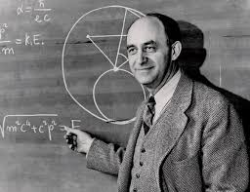
Fermi’s Problem with Intelligent Life Elsewhere:
There are billions of stars in the Milky Way, many of which are similar to our sun and far older.

Slide 40
Fermi’s Problem with Intelligent Life Elsewhere:
There are billions of stars in the Milky Way, many of which are similar to our sun and far older.
With high probability, many of these stars have Earth-like planets orbiting them.

Slide 41
Fermi’s Problem with Intelligent Life Elsewhere:
There are billions of stars in the Milky Way, many of which are similar to our sun and far older.
With high probability, many of these stars have Earth-like planets orbiting them.
If intelligent life and technological civilizations can develop on these planets, many of them would be millions or even billions of years older and more advanced than our own.

Slide 42
Fermi’s Problem with Intelligent Life Elsewhere:
There are billions of stars in the Milky Way, many of which are similar to our sun and far older.
With high probability, many of these stars have Earth-like planets orbiting them.
If intelligent life and technological civilizations can develop on these planets, many of them would be millions or even billions of years older and more advanced than our own.
Even with very slow interstellar travel, it would take an advanced civilization a relatively short cosmic time to colonize or explore the entire galaxy.

Slide 43
Fermi’s Problem with Intelligent Life Elsewhere:
There are billions of stars in the Milky Way, many of which are similar to our sun and far older.
With high probability, many of these stars have Earth-like planets orbiting them.
If intelligent life and technological civilizations can develop on these planets, many of them would be millions or even billions of years older and more advanced than our own.
Even with very slow interstellar travel, it would take an advanced civilization a relatively short cosmic time to colonize or explore the entire galaxy.
Since the Earth has not been visited by aliens and we have not detected any signs of their existence,
where is everybody?

Slide 44


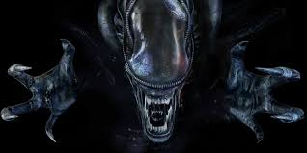
But wouldn’t it be great to find aliens?

Slide 45
Given the fact SETI has found nothing, and Fermi’s problem with that, why do you think we have found nothing?
If we did find something out there, do you think, on balance, that this would be a good thing for this planet?

Slide 46
Ockham’s Razor: “Entities are not to be multiplied without necessity" :
The solution with the fewest assumptions is the most likely one.
Using Ockham’s razor, here are some possible reasons we’ve found nothing out there – ranked in order of simplicity:

Slide 47
Ockham’s Razor “Entities are not to be multiplied without necessity" :
The solution with the fewest assumptions is the most likely one.
Using Ockham’s razor, here are some possible reasons we’ve found nothing out there – ranked in order of simplicity:
Because there is nothing out there. (Brian Cox favours this view)

Slide 48
Ockham’s Razor “Entities are not to be multiplied without necessity" :
The solution with the fewest assumptions is the most likely one.
Using Ockham’s razor, here are some possible reasons we’ve found nothing out there – ranked in order of simplicity:
Because there is nothing out there (Brian Cox favours this view)
Intelligent life is incredibly rare

Slide 49
Ockham’s Razor “Entities are not to be multiplied without necessity" :
The solution with the fewest assumptions is the most likely one.
Using Ockham’s razor, here are some possible reasons we’ve found nothing out there – ranked in order of simplicity:
Because there is nothing out there (Brian Cox favours this view)
Intelligent life is incredibly rare
Advanced civilisations are short-lived

Slide 50
Arguments for being chummy with aliens :
New ideas, new technology?
Perhaps they would introduce us to other civilisations?
New ways of living together?

Slide 51
Arguments for being chummy with aliens:
New ideas, new technology?
Perhaps they would introduce us to other civilisations?
New ways of living together?
Arguments against:
Look what happened when technologically advanced peoples showed up in North America, South America, Australia, Africa.
Perhaps they are so entirely different from us that we don’t see them (different dimension).
Perhaps they’d be appalled at the way we fight wars, eat other creatures and lay waste to our planet

Slide 52
Arguments for being chummy with aliens:
New ideas, new technology?
Perhaps they would introduce us to other civilisations?
New ways of living together?
Arguments against:
Look what happened when technologically advanced peoples showed up in North America, South America, Australia, Africa.
Perhaps they are so entirely different from us that we don’t see them (different dimension).
Perhaps they’d be appalled at the way we fight wars, eat other creatures and lay waste to our planet
Neutral Argument:
Maybe they know we’re here, believe we’re dangerous, and keep themselves to themselves.

Slide 53
What’s stopping us from getting out there and looking around?
In our solar system, the fastest moving object is a comet moving at 209,000 kilometres an hour.

Slide 54
What’s stopping us from getting out there and looking around?
In our solar system, the fastest moving object is a comet moving at 209,000 kilometres an hour.
In our galaxy the fastest moving object is a star circling a black hole which moves at 83,000,000 kilometres per hour or 8% of the speed of light.

Slide 55
What’s stopping us from getting out there and looking around?
In our solar system, the fastest moving object is a comet moving at 209,000 kilometres an hour.
In our galaxy the fastest moving object is a star circling a black hole which moves at 83,000,000 kilometres per hour or 8% of the speed of light.
On that star, time runs 0.3 percent slower than on Earth.

Slide 56
What’s stopping us from getting out there and looking around?
In our solar system, the fastest moving object is a comet moving at 209,000 kilometres an hour.
In our galaxy the fastest moving object is a star circling a black hole which moves at 83,000,000 kilometres per hour or 8% of the speed of light.
On that star, time runs 0.3 percent slower than on Earth.
But even if you travelled on that fastest star to the nearest sun to our sun, it would still take 50 years.

Slide 57
What’s stopping us from getting out there and looking around?
In our solar system, the fastest moving object is a comet moving at 209,000 kilometres an hour.
In our galaxy the fastest moving object is a star circling a black hole which moves at 83,000,000 kilometres per hour or 8% of the speed of light.
On that star, time runs 0.3 percent slower than on Earth.
But even if if you travelled on that fastest star to the nearest sun to our sun, it would still take 50 years.
The fastest spaceship we have ever built travels at around 50.000 kilometres per hour. It would take 75,000 years to reach that nearest sun.

Slide 58
What’s stopping us from getting out there and looking around?
In our solar system, the fastest moving object is a comet moving at 209,000 kilometres an hour.
In our galaxy the fastest moving object is a star circling a black hole which moves at 83,000,000 kilometres per hour or 8% of the speed of light.
On that star, time runs 0.3 percent slower than on Earth.
But even if if you travelled on that fastest star to the nearest sun to our sun, it would still take 50 years.
The fastest spaceship we have ever built travels at around 50.000 kilometres per hour. It would take 75,000 years to reach that nearest sun.
The problem is that our space travel today is based on the idea of a rocket.

Slide 59
What’s stopping us from getting out there and looking around?
In our solar system, the fastest moving object is a comet moving at 209,000 kilometres an hour.
In our galaxy the fastest moving object is a star circling a black hole which moves at 83,000,000 kilometres per hour or 8% of the speed of light.
On that star, time runs 0.3 percent slower than on Earth.
But even if if you travelled on that fastest star to the nearest sun to our sun, it would still take 50 years.
The fastest spaceship we have ever built travels at around 50.000 kilometres per hour. It would take 75,000 years to reach that nearest sun.
The problem is that our space travel today is based on the idea of a rocket.
The first rocket was invented in China around 900 AD

Slide 60
What’s stopping us from getting out there and looking around?
In our solar system, the fastest moving object is a comet moving at 209,000 kilometres an hour.
In our galaxy the fastest moving object is a star circling a black hole which moves at 83,000,000 kilometres per hour or 8% of the speed of light.
On that star, time runs 0.3 percent slower than on Earth.
But even if if you travelled on that fastest star to the nearest sun to our sun, it would still take 50 years.
The fastest spaceship we have ever built travels at around 50.000 kilometres per hour. It would take 75,000 years to reach that nearest sun.
The problem is that our space travel today is based on the idea of a rocket.
The first rocket was invented in China around 900 AD
Once you’ve burnt all the fuel in a rocket, that’s as fast as you’re gong to go. It’s very primitive.

Slide 61
Any other ways to travel?
Spaceships using solar wind will travel as fast as rockets through space, but they can only travel around the solar system. (Sun powered)
Similar technology but propelling ship from ground-based lasers is also promising.

Slide 62
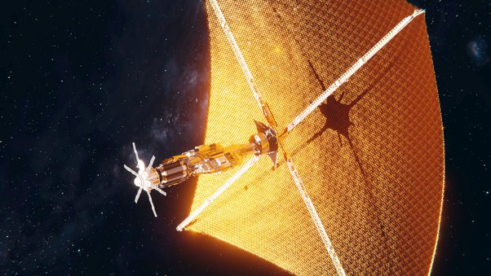

Slide 63
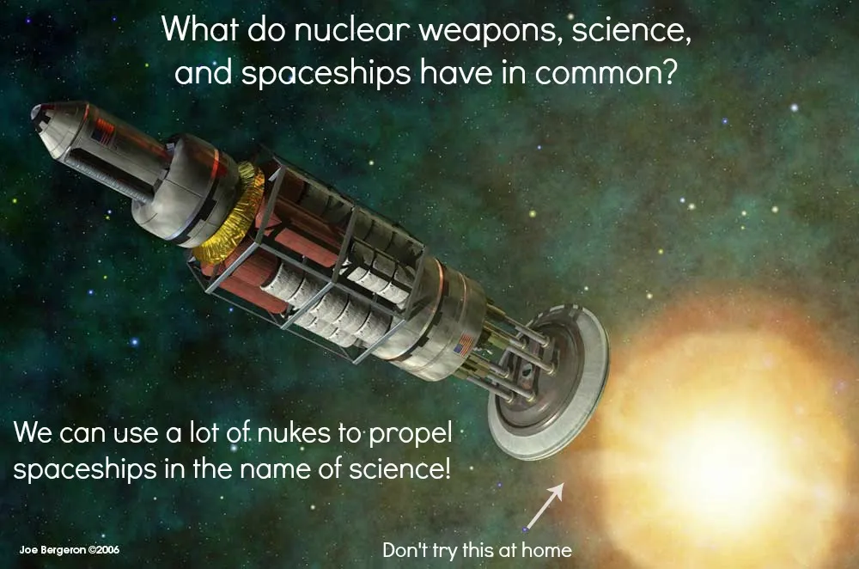
Nuclear pulse technology is theoretically possible – basically a series of small nuclear explosions providing a push to a rear shield. A ship like that could reach around 5% of the speed of light. But it would still take 80 years to get to the nearest sun and the chances of finding life there are remote.

Slide 64
But why not keep pushing, keep creating nuclear explosions, so the rocket went faster and faster, so that eventually it reached the speed of light (186,000 miles per second)?

Slide 65

So, suppose we travelled at the speed of light?
Einstein proved that if you could travel at the speed of light, time – for you – would stop. In sum, you’d arrive at your destination the moment you started.
Perfect for space travel. We could travel across the universe in an instant of time.

Slide 66
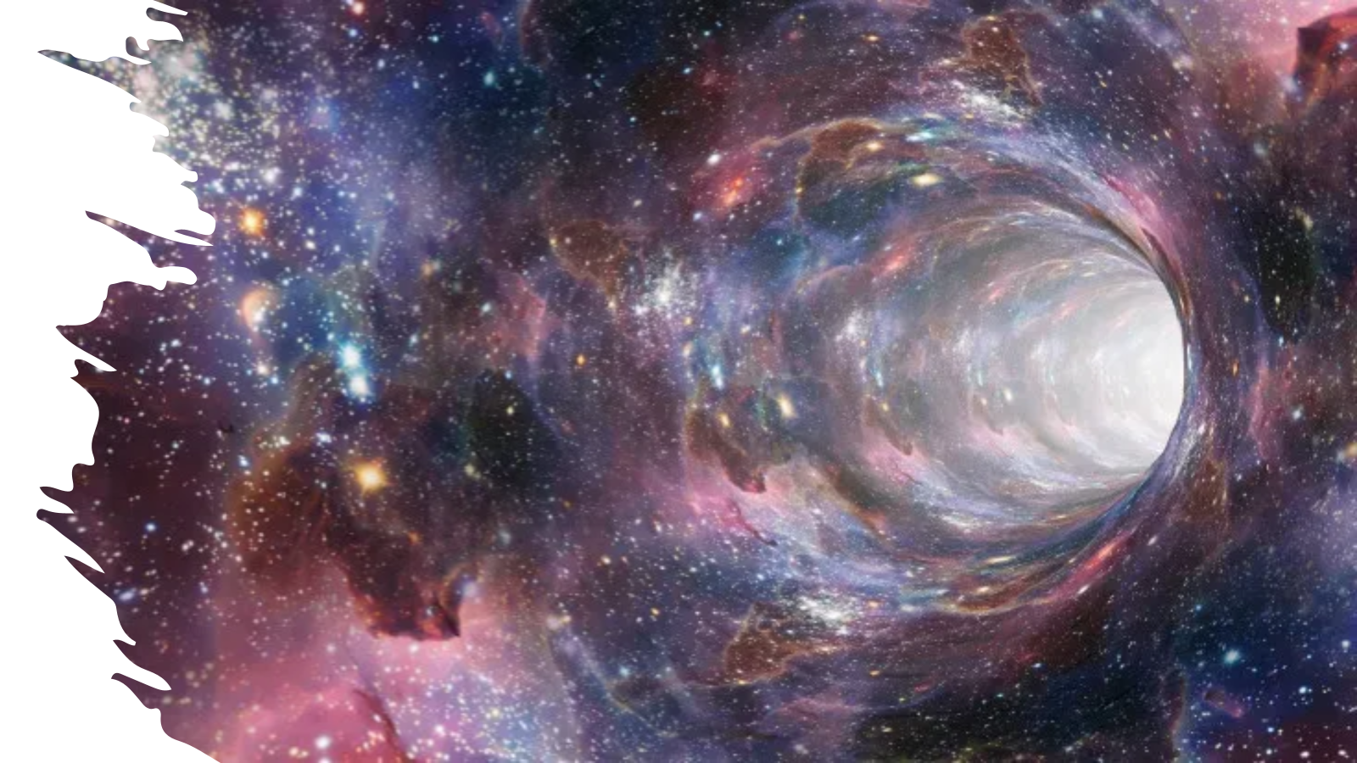
So what happens if we get to light speed?
One small problem. To propel any object with a mass (e.g. us) at light speed, you need an infinite amount of energy. It’s a physical law of the universe. The only possibility to travel great distances is perhaps through massive distortions in space like wormholes, or possibly black holes. (Good luck with that!)

Slide 67
Elon Musk’s ‘Plan B’
The Core Premise: Earth faces existential risks that could end human civilization, so we need a backup location to ensure species survival. E.g: asteroid impacts, nuclear war, climate change, pandemics.
Why Mars Specifically:
Proximity - closest potentially habitable planet
Day length - 24.6 hours, similar to Earth
Seasons - has tilted axis like Earth
Water resources - polar ice caps and subsurface water
Atmosphere - thin but contains CO2 (useful for fuel production)
Gravity - 38% of Earth's (potentially manageable long-term)
The Strategic Logic:
Redundancy principle - Don't put all eggs in one basket
Self-sufficiency requirement - Mars colony must eventually survive without Earth
Technology forcing function - Mars colonization drives innovation that benefits Earth
Timescale urgency - Establish colony while Earth civilization is advanced enough to support it

Slide 68
There are a couple of problems……..
Cost - Even with reusable rockets, the project is extremely expensive (Estimates $100 billion to $1000 trillion)
Launch windows - Mars is only optimally reachable every 26 months
Journey time - 6-9 month trips with current technology
Payload limitations - Can only bring essentials, you will have to manufacture most things on Mars
Atmosphere - 95% CO2, only 0.1% oxygen. You will die without an artificial air supply
Radiation - No magnetic field or thick atmosphere to block cosmic rays and solar radiation – you will suffer from radiation sickness ( around 5% will die)
Temperature - Average -80°F (-62°C), extreme daily variations
Pressure - Less than 1% of Earth’s; we’d need pressurized environments or spacesuits outdoors
Dust storms - Planet-wide storms can last months, blocking solar power
Water access - Must extract from ice or underground sources
No soil, must create controlled growing environments

Slide 69
Question:
1. What do you think are the problems – moral and psychological – for and against Musk’s ‘Plan B’?
2. Knowing what you now know, for what reasons should we:
Travel to other planets?
Travel to other stars?

