Slide 1
EMOTION
Good or Bad for us?

Slide 2
What we will be discussing today:
What are emotions and why do we have them?
Is emotion optional? – Can we choose not to have them?
How does emotion affect our thinking?
Would we be better off without emotion?

Slide 3
What is emotion?
Emotion is the revelation of value in the external world – it always has been. “Emotion hooks us on to the world” Aristotle
Objects of value, are the things in this world which will support an organism’s drive towards homeostasis.
Mammals react to objects of value with an emotional behaviour.

Slide 4
What is emotion?
What are the basic (primitive) motions shared by mammals?:
RAGE
FEAR
SEEKING
MATERNAL CARE
PANIC
PLAY
LUST

Slide 5
What is emotion?
Nature rewards us when we realise value:
Victory in conflict – exultation (RAGE)
Escape from threat – relief (FEAR)
Eating – repleteness (SEEKING)
Maternal affection – intimacy (CARE)
Play – enjoyment of play (PLAY)
Sex – orgasm (LUST)

Slide 6
What is emotion?
Homeostasis is what happens when value is realised:
Spinoza: “Each particular thing, interacting with other particular things within the common order of Nature, exhibits a characteristic tendency to cohesion and to the preservation of its identity, a striving, so far as it lies in itself to do so, to persist in its own being” (ST addition) “or to promote the propagation of its species.”

Slide 7
What is emotion?
What Spinoza was saying is that every animal functions by having an innate sense of those things that will keep it alive, and by acting towards those things in an appropriate manner.

Slide 8
What is emotion?
What Spinoza was saying is that every animal functions by having an innate sense of those things that will keep it alive, and by acting towards those things in an appropriate manner.
Humans are no different; it’s just that the amount of stuff we believe to be valuable for our wellbeing is enormous compared to any other animal.

Slide 9
What is emotion?
What a cat needs for homeostasis:
Predator recognition (FEAR)
Food (SEEKING in response to hunger)
Water (SEEKING in response to thirst)
Shelter (SEEKING in response to cold and wet)
Protection and nourishment as a kitten (PANIC,CARE)
Contact with cats of the other gender (LUST)
Recognise constraints to these things (RAGE)

Slide 10
What is emotion?
What a human needs for homeostasis:
Threat detection: wars, famine, avoidance of risk (e.g.cars) job loss, child welfare - you name it. FEAR
Food, Drink, Housing, Household Goods, Land, Cars, Cats, educational qualifications, wealth, children’s wellbeing etc.. (SEEKING)
Family ties (CARE/PANIC)
Sexual (LUST)
Response to anyone stopping us from doing these things (RAGE)

Slide 11
What is emotion?
There is a final emotion in mammals which is PLAY. In mammals, this often takes place between young animals, mostly siblings. It is the way young animals test their bodies and physical skills against other animals. We see the same effect, much extended and elaborated, in humans.

Slide 12
What is emotion?
Here are Maslow’s objects of human value:
safety, job security/pension, achievement, food, water, self actualization, family, society, shelter.
Imagine they are taken away from you. How would you prioritise them objectively in order of importance to you?

Slide 13
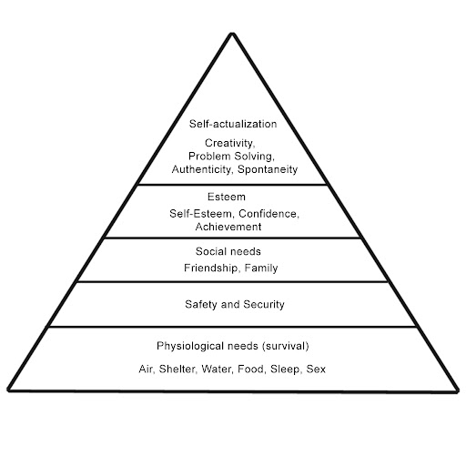

What is emotion?
Maslow’s Pyramid of Human Needs
SEEKING
Joy, Exultation, Gratification, Relief
CARE. PANIC, LUST, PLAY, RAGE
FEAR, RAGE
SEEKING, RAGE
Predators – Human, Animal
FEAR, RAGE

Slide 14
What is emotion?
Emotional Impulses and Behaviours
Primitive emotional behaviours will enable a simple mammal, e.g. a mouse or a monkey, to survive without thought. They act as automatic responses to valuable environmental stimuli.

Slide 15
What is emotion?
All emotions have a characteristic behavioural impulse:
FEAR: Flee or freeze
RAGE: Aggression to overcome constraint
SEEKING: Forage for food, water, shelter
CARE/PANIC: Parent feeding offspring/ offspring nourishment and attention.
LUST: Mating
PLAY: Play

Slide 16
What is emotion?
Primitive emotional behaviours do not work well in advanced human societies. We have developed sophisticated brain functions which will override basic emotional behaviours in most situations, but the behavioural impulses remain.

Slide 17
Is emotion optional? Group Questions:
You are a judge and have just heard an appalling case of child abuse. You know what the outline sentencing conditions are, and you feel that in this case they are inadequate:
1. Can you in all honesty eliminate your emotion sufficiently to come up with a judgement which will stand on appeal?
2. If not, how should you deal with your emotion in this case?
3. General question: Given the explanation I have given, is it ever possible to say that you can complete eliminate emotional feelings when a strong emotional stimulus is present. (e.g. How can you be like the hero in a gunfight, so your hands don’t shake?)

Slide 18
How does emotion affect our thinking?

Slide 19
How does emotion affect our thinking?
(as in ‘affection’)

Slide 20
Emotion in the brain works as a feedback mechanism between the lower brain (Limbic System) which prompts us to act - and the higher brain (Cortex/Neocortex) which tells us whether and/or how we should respond to the limbic system’s impulse. This is known as a ‘dual process’ mechanism

Slide 21
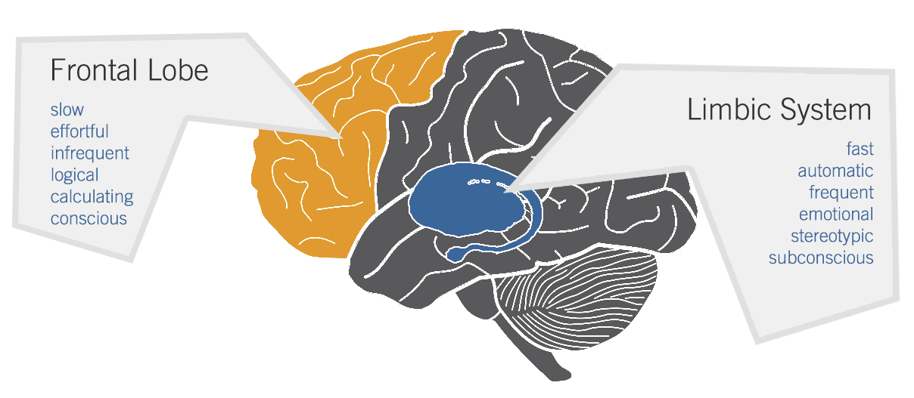

If you do that, you’ll go to jail. What’s a better way to do this?
Type 2 Thinking
Type 1
Thinking
Hit him!

Slide 22
Type 1 Brain Processes | Type 2 Brain Processes
Primitive Emotion | Emotional evaluation
Happens fast – milliseconds | Happens slowly
Automatic | Controlled
High Capacity (no working memory) | Limited Capacity (working memory)
Nonconscious | Conscious
Biased responses | Considered responses
Associative | Rule-based
Experience based | Conceptually based
No cognitive ability required | Corresponds to cognitive ability

Slide 23
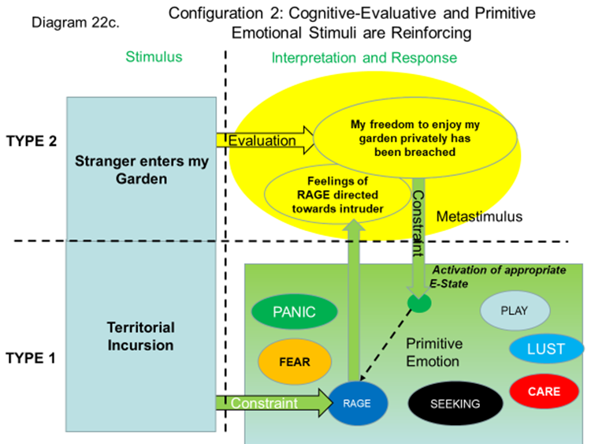
What happens in your brain when a stranger enters your garden and starts sunbathing

Slide 24
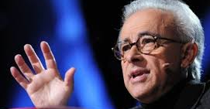

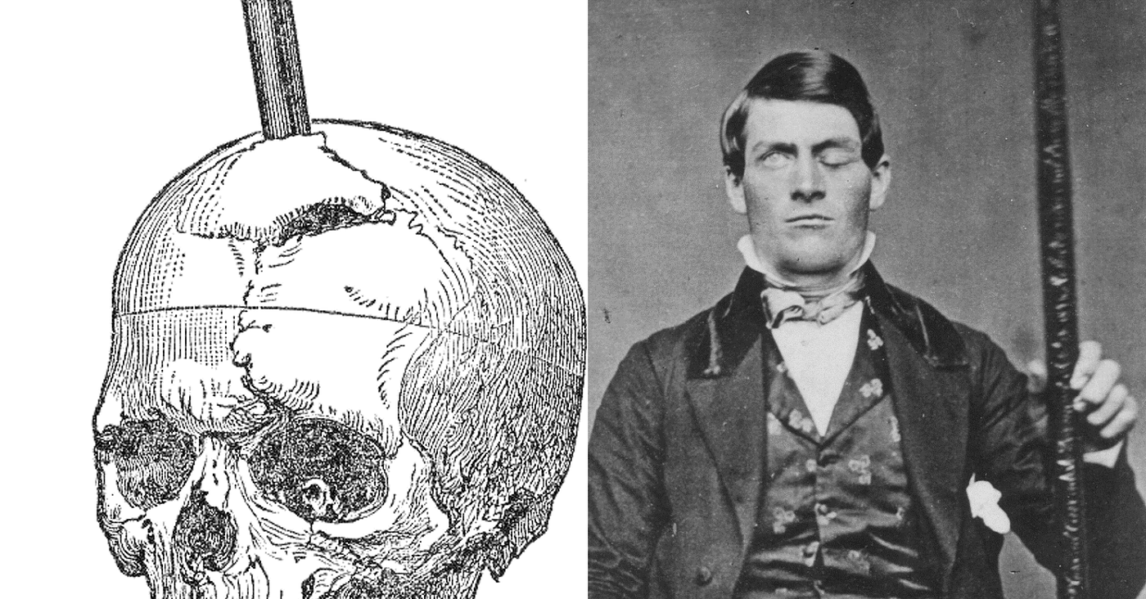
Antonio Damasio:
Neuroscientist, Psychologist
Emotions are essential for rational thinking
The story of Phineas Gage

Slide 25
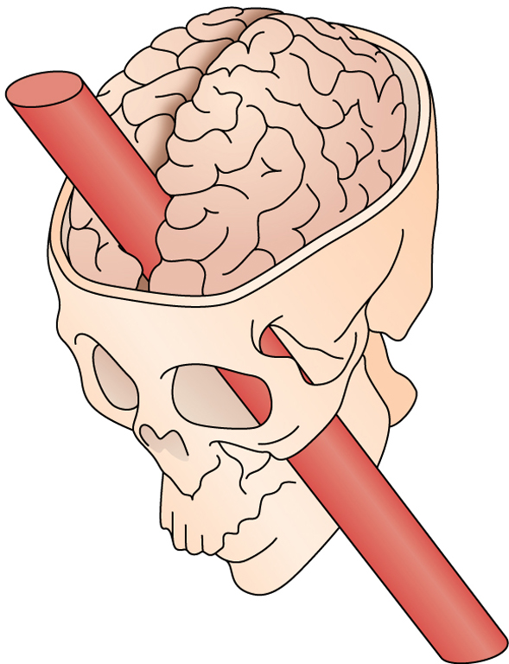
Selective damage in the prefrontal cortices of Phineas Gage’s brain compromised his ability to plan for the future, to conduct himself according to the normal rules of society, and to decide the course of action most advantageous to society.
Conclusion:
The prefrontal cortex is able to modify our emotional impulses in order to fit in with society and plan our future.

Slide 26
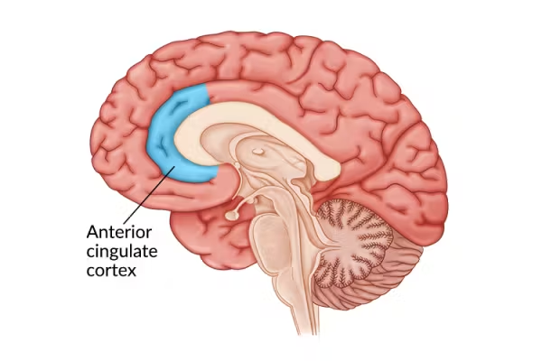
The Anterior Cingulate Cortex is where the prefrontal cortex and the emotional signals from the limbic system meet, exchange information and ‘negotiate’ and decide to act.
Mrs T had a stroke which caused damage to the ACC (amongst other brain areas)
Damasio observed that she laid passive, little bodily motion, occasional speech, but only when prompted. Would not answer questions.
When she recovered she said she remembered no thinking, no feeling, no impulse to act.

Slide 27
Question for the Groups:
Imagine you have received a job offer with a salary which is 50% above your present salary.
The job requires relocation to another town
Your partner has a part-time teaching job which he/she enjoys
You have friends locally
Your kids are settled in their schools and have their own friendship groups
The new town doesn’t seem to have a great reputation for schools
The housing there is around the same price, so you could get a better house on your new wage
The job also means you will get a car
This is an important family decision which will affect the lives of your entire family. How would you go about making the decision whether or not to take the job? Could a successful decision be made unemotionally?

Slide 28
General Group Discussion.
1, When you choose to buy a piece of clothing, how much would you be able to reason your way to a design and colour?
2. When choosing between four brands of washing powder on the supermarket shelf with slightly different weights and prices, how much reason is involved in your final choice?
3. Why were adverts which flashed subliminal images banned?
4. How did you choose your favourite piece of music?

Slide 29
So is emotion good or bad for us? – My conclusions:
1. Whenever we are in the presence of the objects we value, we will experience an emotion. There is nothing we can do to avoid that.
3. An emotion is a bodily representation of the outside world, making it real for us and giving us a physical ‘push’ to act. (Martha Nussbaum describes her reaction to her mother’s death as like a nail being driven into her gut)
4. Raw expressions of emotion are generally unhelpful. However, all primitive emotions and impulses are scanned in the prefrontal cortex before being translated into action. That is a perfectly natural process. We invested a lot of evolutionary capital in being able to suppress our emotions.
5. So, without primitive emotions we could not act, but we achieve emotional control by using our ‘reasoning’ higher brain areas. Both phenomena are absolutely necessary for a great ape to function in vast complex societies.

